Slide 1
Microglia regulation of sleep homeostasis
Joe Stucynski, Hypothesis Testing, 11/30/22

Slide 2
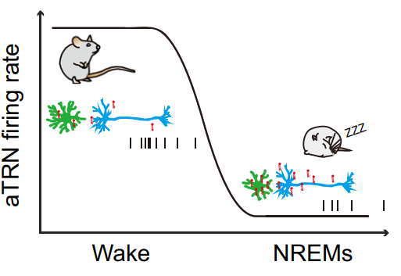
Microglia control diurnal rhythm of neuronal lipid byproducts in Thalamic Reticular Nucleus, affecting sleep
Wake:
Microglia retracted / not clearing
Ceramide levels low but gradually build up
TRN firing rate high to maintain stability of wakefulness
Sleep:
Microglia in surveillance mode
High ceramide build up inhibiting TRN thereby promoting sleep
Microglia actively clear ceramides during sleep
Liu et al. 2021

Slide 3
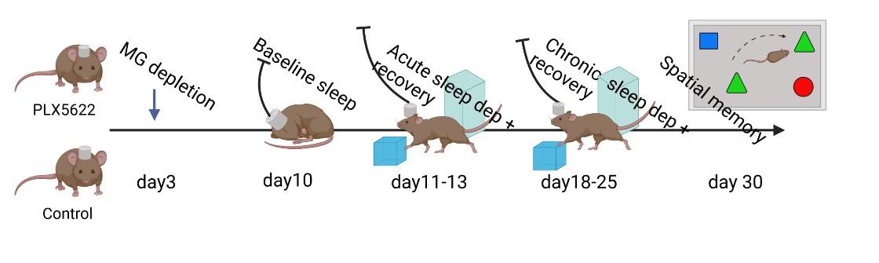
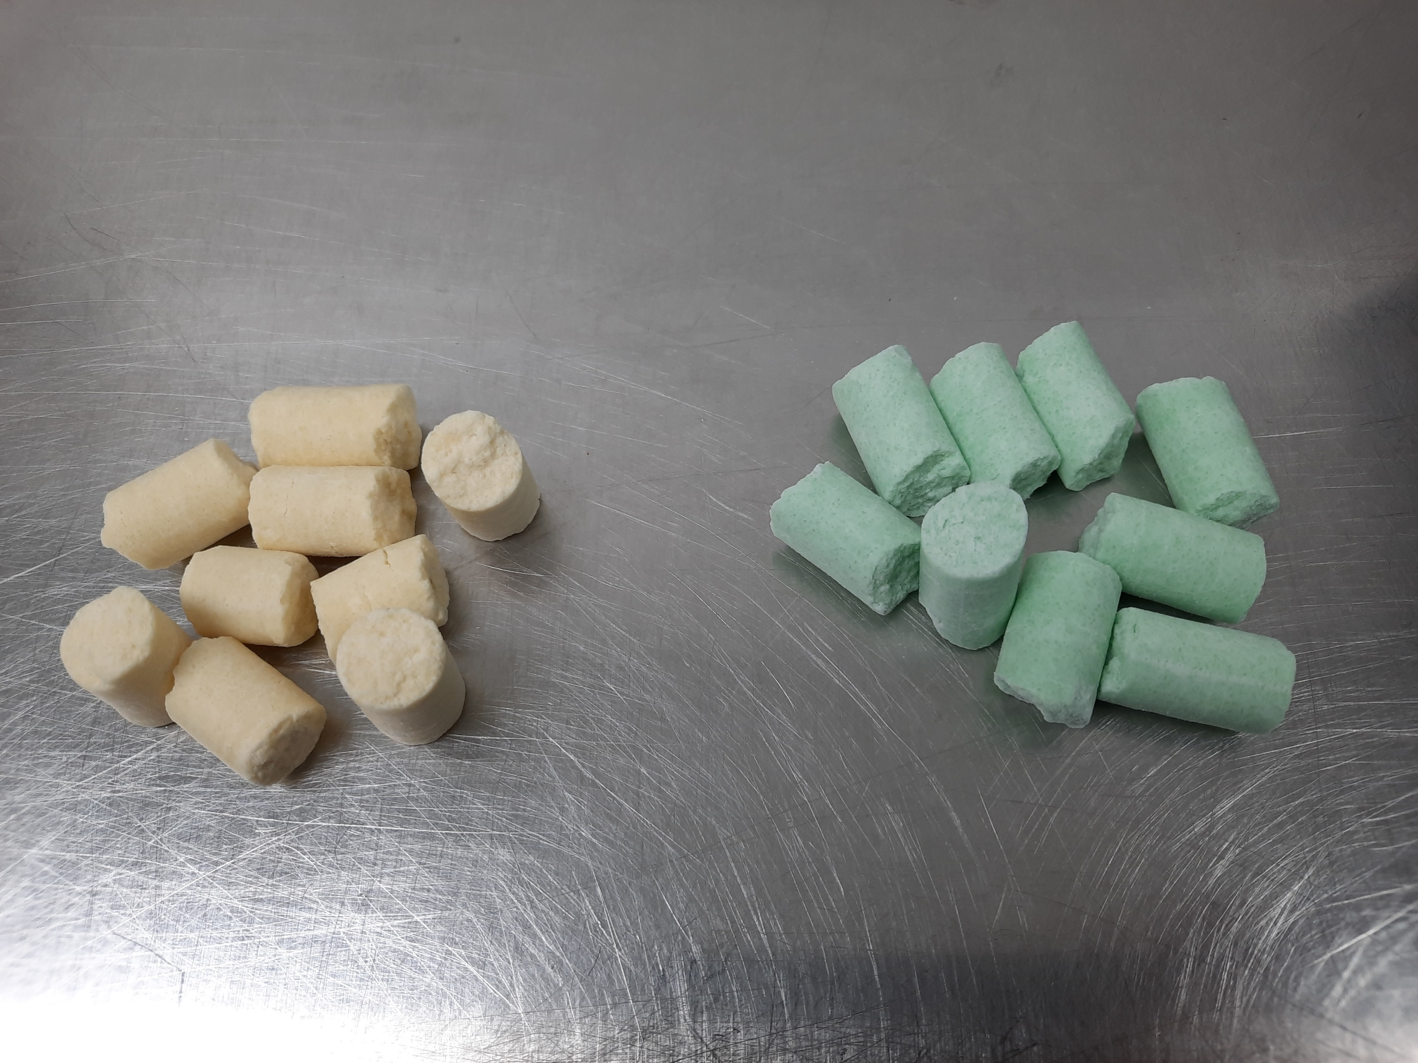
General Hypothesis: Microglia depleted mice have impaired homeostatic responses to sleep deprivation.
Null Hypothesis:
Depleting microglia does not affect sleep homeostasis.
Day 1
Day 7
Day 8
Post depletion baseline
Dep.
Recovery
0
6
12
24
30
36
48

Slide 4
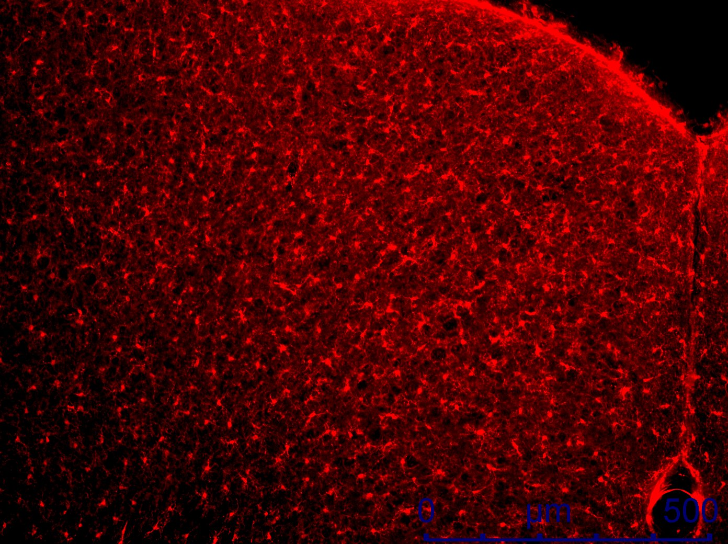
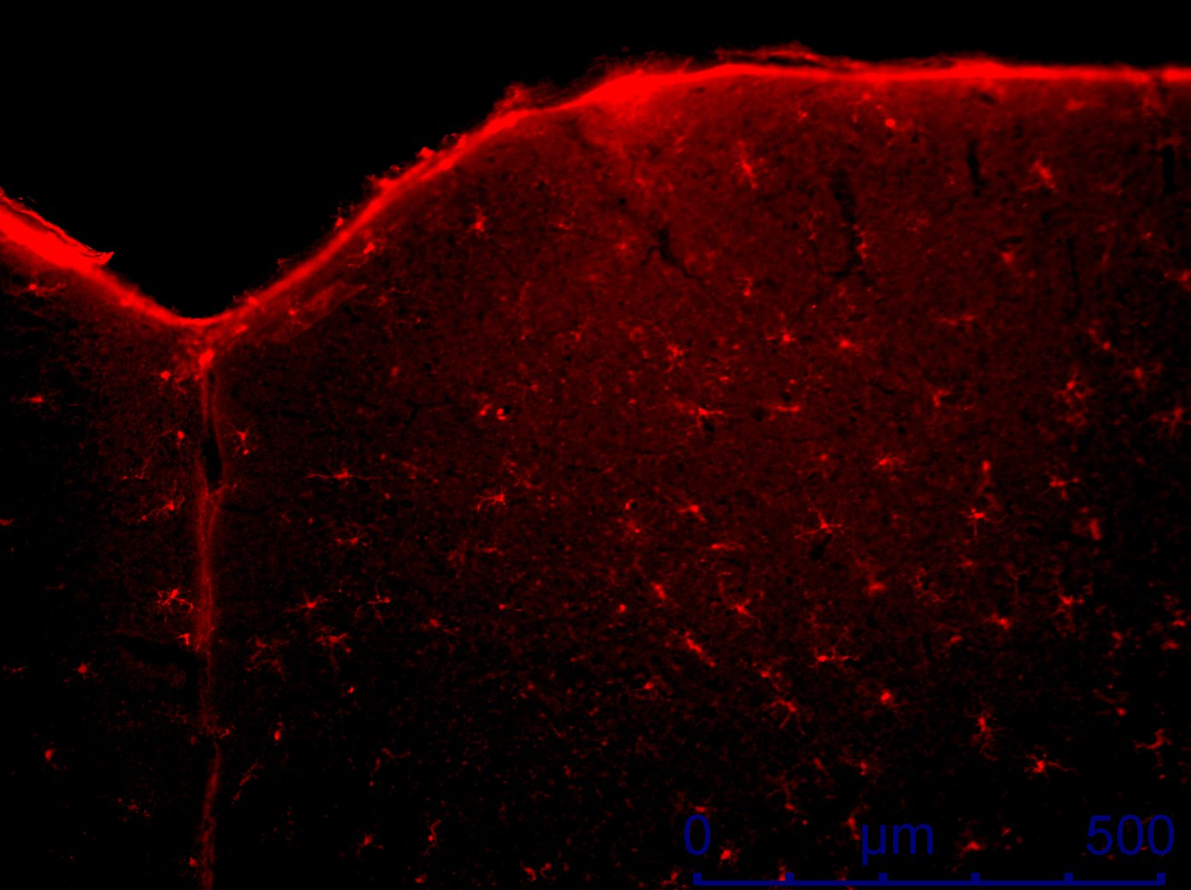
Successful Microglia Knockdown
Green Food
Yellow Food

Slide 5
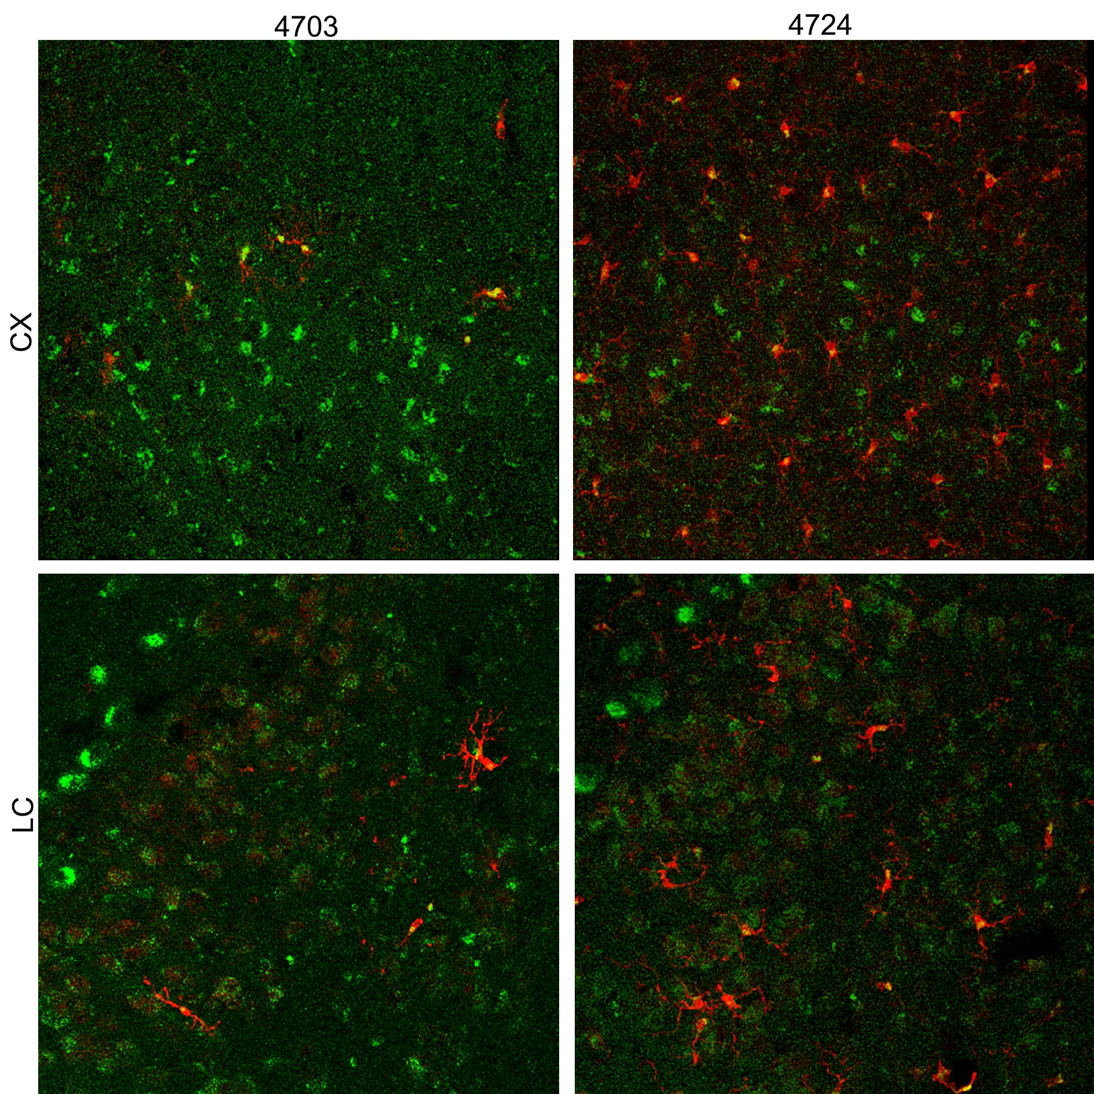
Successful Microglia Knockdown
Yellow Food
Green Food
Motor Cortex
Locus Coeruleus

Slide 6



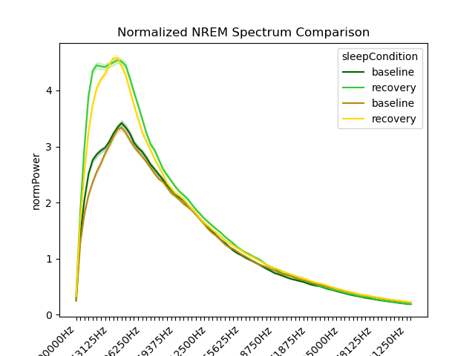
N = 10 per condition
0
20
Frequency

Slide 7
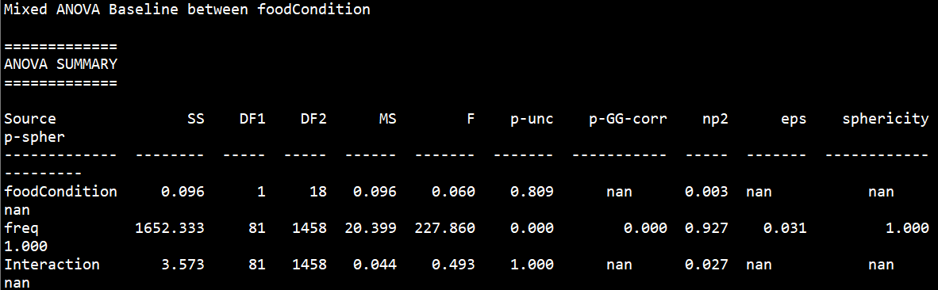
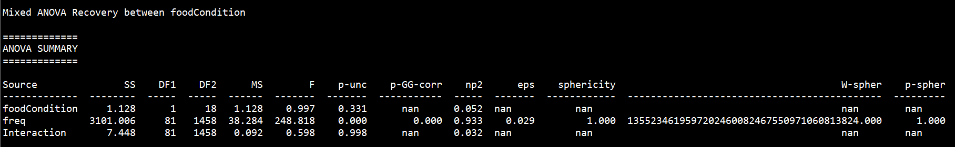
Mixed ANOVA – Baseline
Between: Green vs Yellow, Within: Frequency
N = 10 per condition
Mixed ANOVA – Recovery
Between: Green vs Yellow, Within: Frequency
0
Frequency

Slide 8
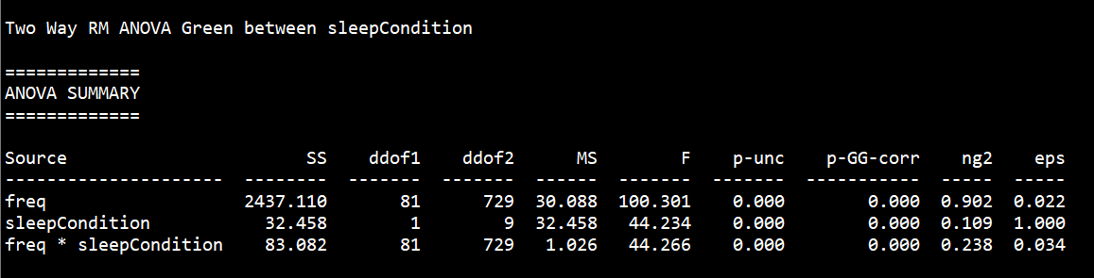
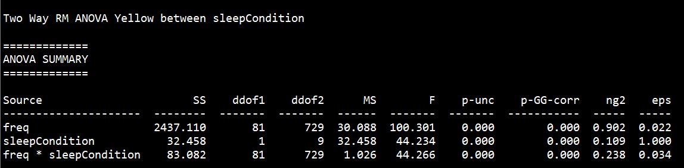
Mixed ANOVA – Baseline
Between: Green vs Yellow, Within: Frequency
N = 10 per condition
Mixed ANOVA – Recovery
Between: Green vs Yellow, Within: Frequency
Two Way repeated Measures ANOVA – Green
Within: Baseline/Recovery + Frequency
Two Way repeated Measures ANOVA – Yellow
Within: Baseline/Recovery + Frequency
0
Frequency

Slide 9
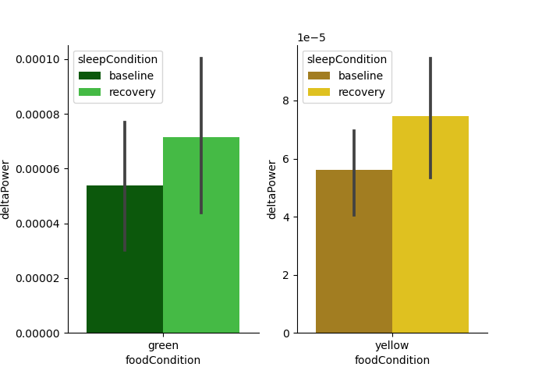
Paired Comparison over just Delta range (0.5-4 Hz)
Main effect of Sleep Condition
(Baseline vs Recovery)

Slide 10
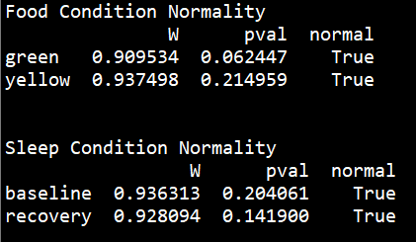
Paired Comparison over just Delta range (0.5-4 Hz)
pg.normality() uses: scipy.stats.Shapiro()
Shapiro-Wilk test for normality
Main effect of Sleep Condition
(Baseline vs Recovery)

Slide 11
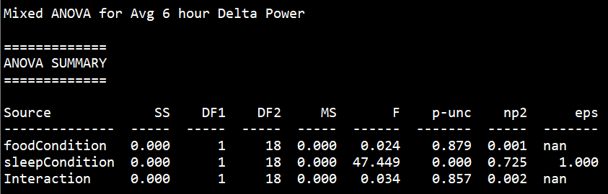
Paired Comparison over just Delta range (0.5-4 Hz)
pg.normality() uses: scipy.stats.Shapiro()
Shapiro-Wilk test for normality
Mixed ANOVA
Only significant main effect of sleep condition
Main effect of Sleep Condition
(Baseline vs Recovery)

Slide 12
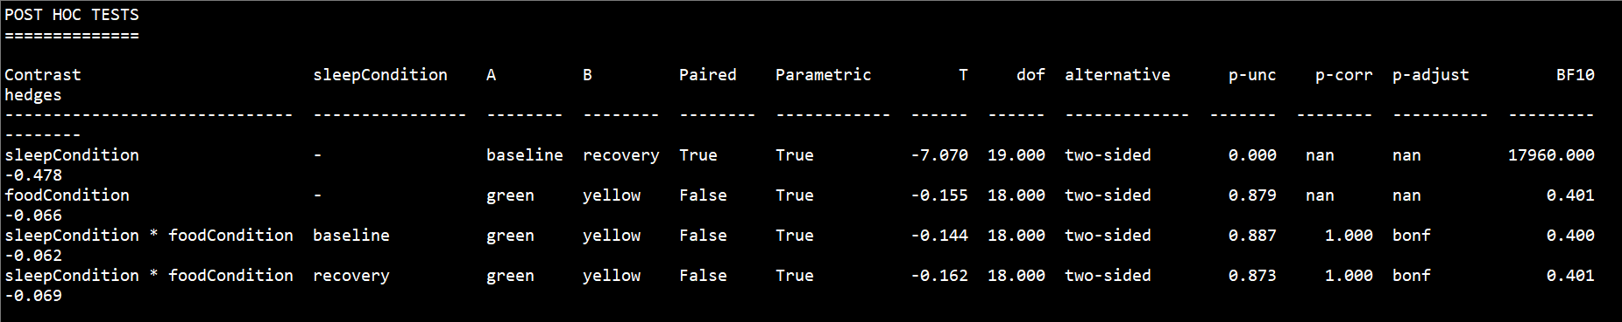
Paired Comparison over just Delta range (0.5-4 Hz)
pg.normality() uses: scipy.stats.Shapiro()
Shapiro-Wilk test for normality
Mixed ANOVA
Only significant main effect of sleep condition
Main effect of Sleep Condition
(Baseline vs Recovery)
Only sleep condition is significant

Slide 13
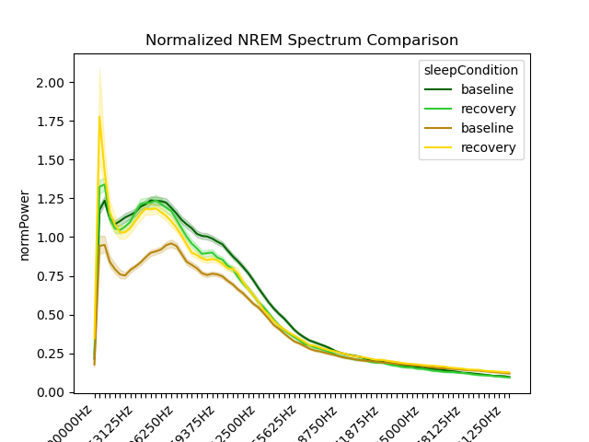
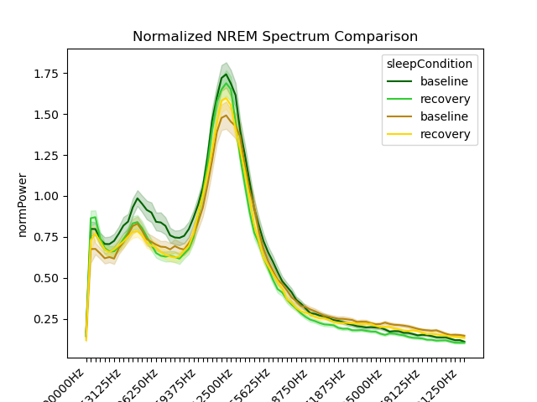
Wake
REM

Slide 14
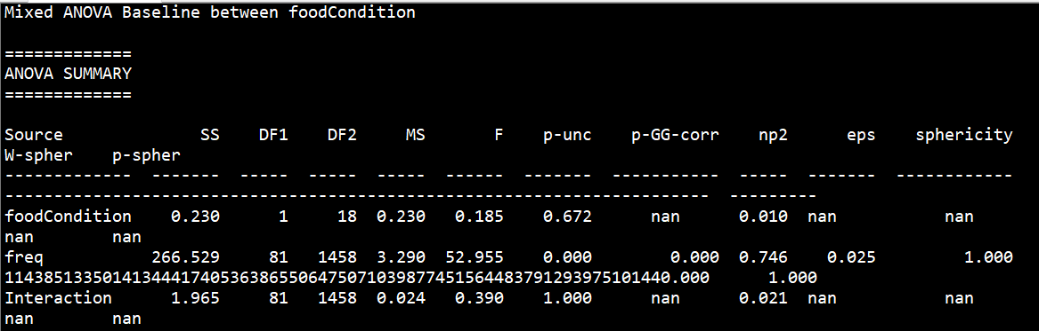
Wake
REM
ANOVA for REM at baseline between Green/Yellow

Slide 15
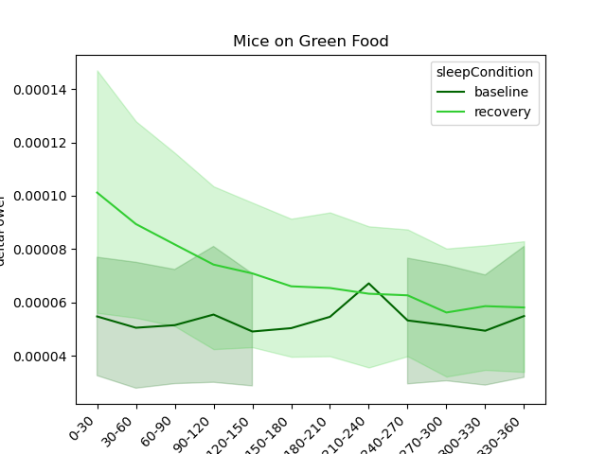
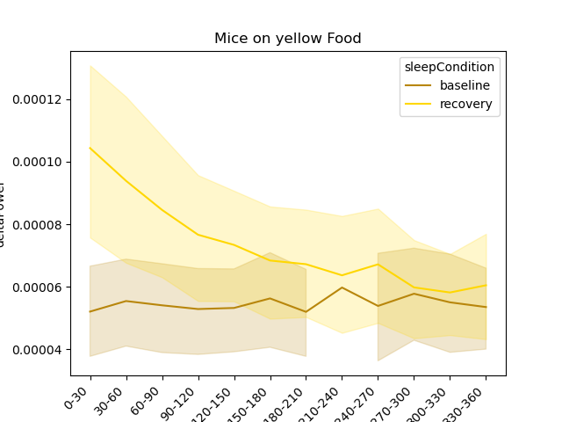
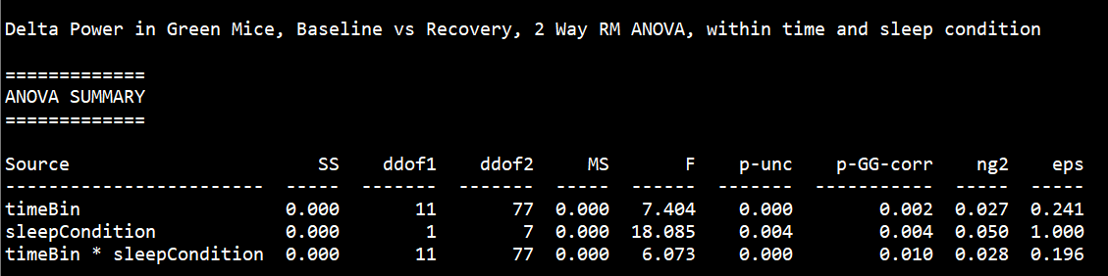
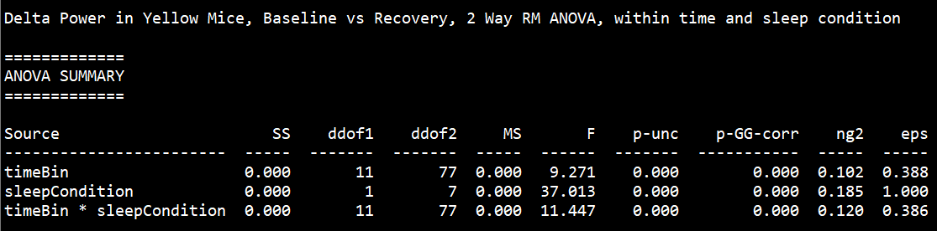
Raw Delta Power during NREM Sleep Across 6 hours
30 min bins
2 Way Repeated Measures ANOVA
- Significant Main effect of Time + Sleep Condition
- Significant Interaction
2 Way Repeated Measures ANOVA
- Significant Main effect of Time + Sleep Condition
- Significant Interaction

Slide 16
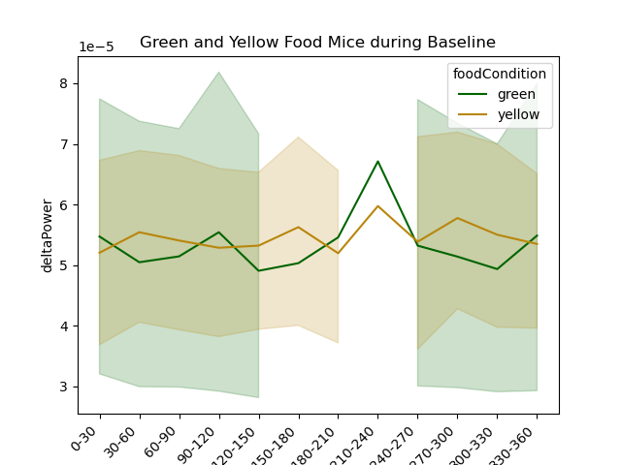
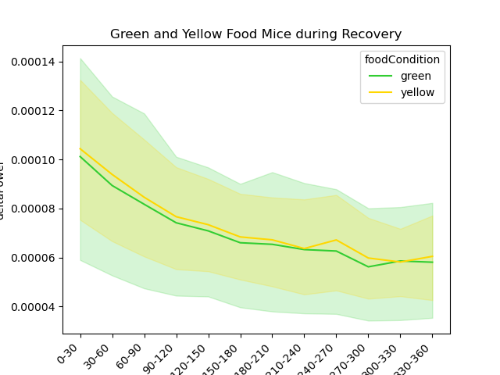
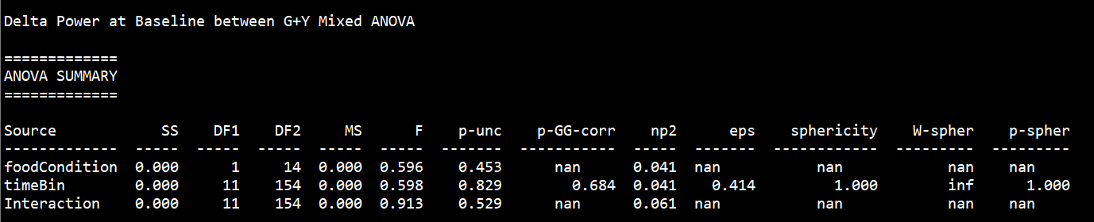
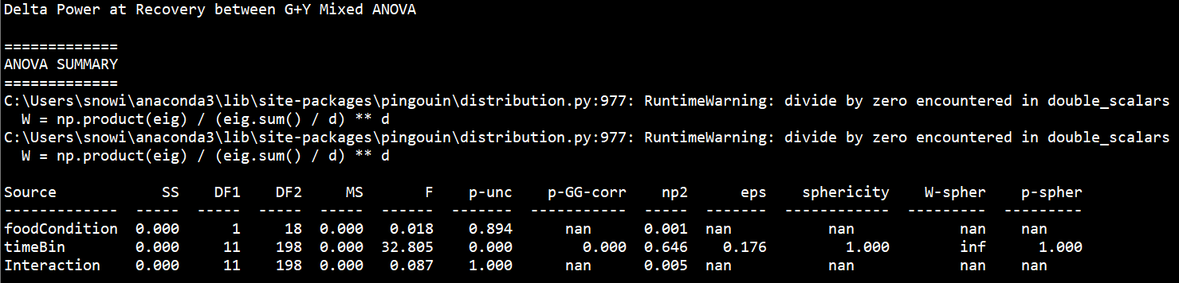
Raw Delta Power during NREM Sleep Across 6 hours
30 min bins
Mixed ANOVA - No Interaction effect
Mixed ANOVA – Main effect of Time
-- No Interaction effect

Slide 17
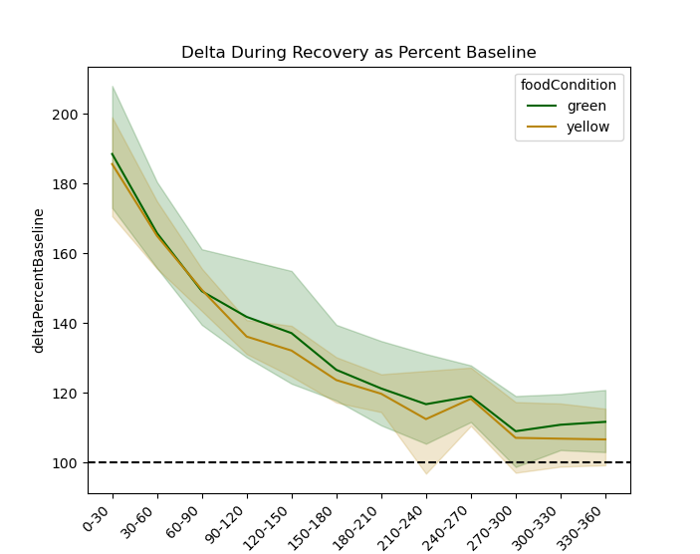
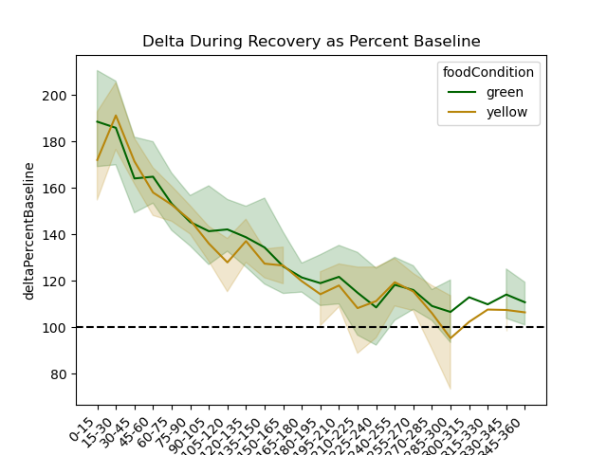
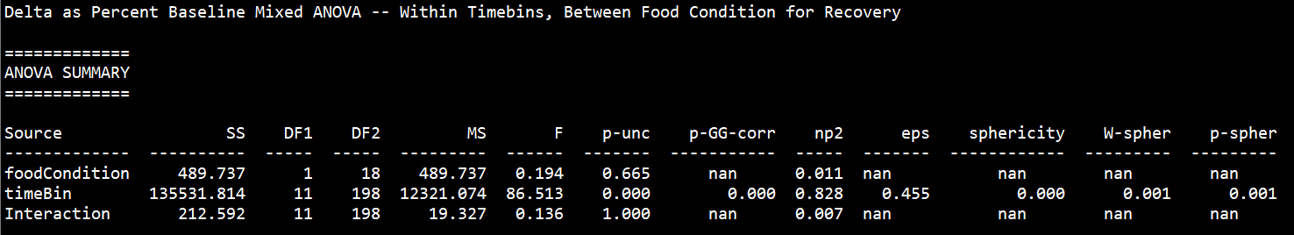
Normalized Delta Power during NREM Sleep Across 6 hours
% of baseline delta power
% of baseline delta power
Time (30min bins)
Time (15min bins)
Mixed ANOVA – Significant Main effect of time, No main effect of food or interaction

Slide 18
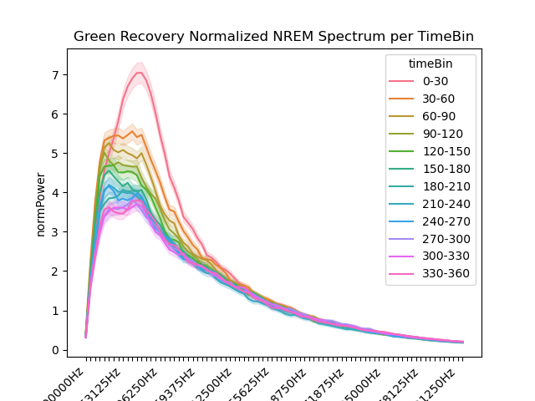
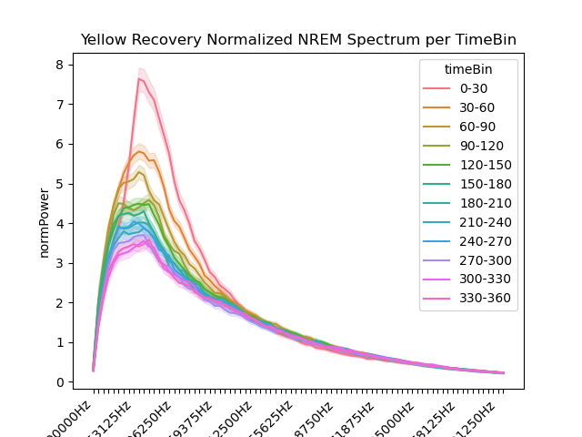
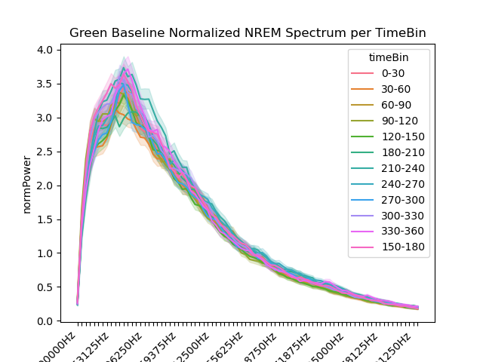
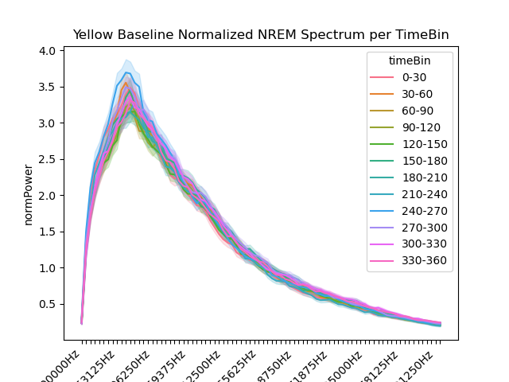
Green
Yellow
30 min bins

Slide 19
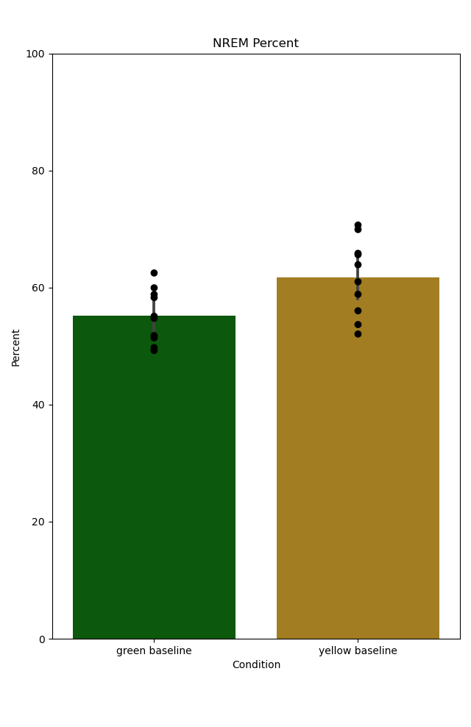
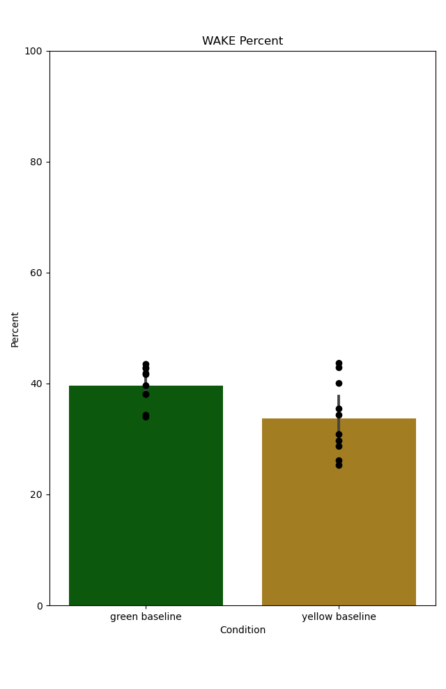
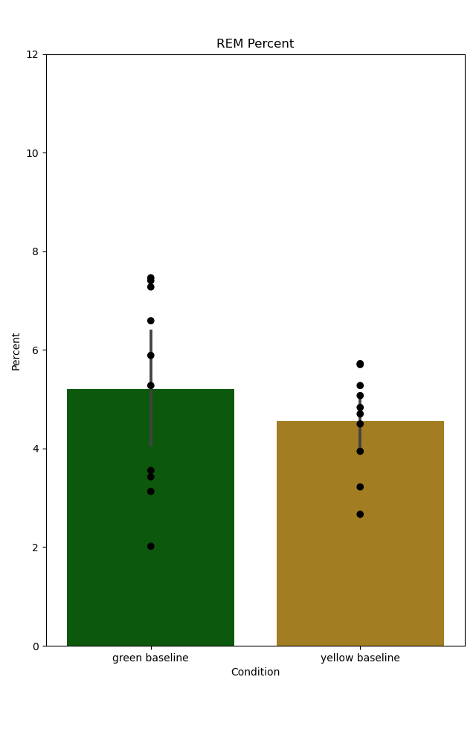
Sleep Summary Statistics
Run normality on both distributions to be compared, choose Parametric ttest vs nonparametric
###### Baseline ######
NREM Percent Baseline Unpaired TTest
T dof alternative p-val CI95% cohen-d BF10 power
-2.613 18 two-sided 0.018 [-11.9 -1.29] 1.169 3.463 0.696
------ ----- ------------- ------- --------------- --------- ------ -------
NREM Duration Baseline MannWhitneyU Test
U-val alternative p-val RBC CLES
23.000 two-sided 0.045 0.540 0.230
------ ----- ------------- ------- --------------- --------- ------ -------
NREM Frequency Baseline Unpaired TTest
T dof alternative p-val CI95% cohen-d BF10 power
0.932 18 two-sided 0.364 [-2.34 6.07] 0.417 0.539 0.143
------ ----- ------------- ------- --------------- --------- ------ -------
WAKE Percent Baseline Unpaired TTest
T dof alternative p-val CI95% cohen-d BF10 power
2.493 18 two-sided 0.023 [ 0.94 10.98] 1.115 2.902 0.655
------ ----- ------------- ------- --------------- --------- ------ -------
WAKE Duration Baseline MannWhitneyU Test
U-val alternative p-val RBC CLES
66.000 two-sided 0.241 -0.320 0.660
------ ----- ------------- ------- --------------- --------- ------ -------
WAKE Frequency Baseline Unpaired TTest
T dof alternative p-val CI95% cohen-d BF10 power
0.787 18 two-sided 0.442 [-2.62 5.75] 0.352 0.494 0.116
------ ----- ------------- ------- --------------- --------- ------ -------
REM Percent Baseline Unpaired TTest
T dof alternative p-val CI95% cohen-d BF10 power
0.891 18 two-sided 0.385 [-0.87 2.15] 0.398 0.525 0.135
------ ----- ------------- ------- --------------- --------- ------ -------
REM Duration Baseline Unpaired TTest
T dof alternative p-val CI95% cohen-d BF10 power
-2.737 18 two-sided 0.014 [-23.24 -3.06] 1.224 4.172 0.735
------ ----- ------------- ------- --------------- --------- ------ -------
REM Frequency Baseline Unpaired TTest
T dof alternative p-val CI95% cohen-d BF10 power
2.131 18 two-sided 0.047 [0.01 1.99] 0.953 1.769 0.523
------ ----- ------------- ------- --------------- --------- ------ -------
Baseline Percentages (6 hours) – Unpaired ttests
NREM
Wake
REM
P=0.018
P=0.023
P=0.385
Green Baseline
Yellow Baseline

Slide 20
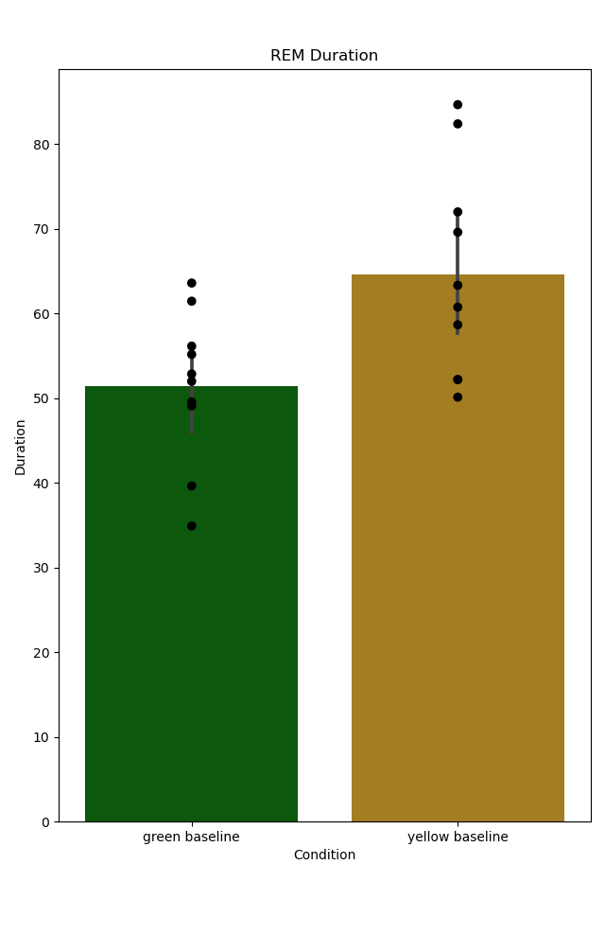
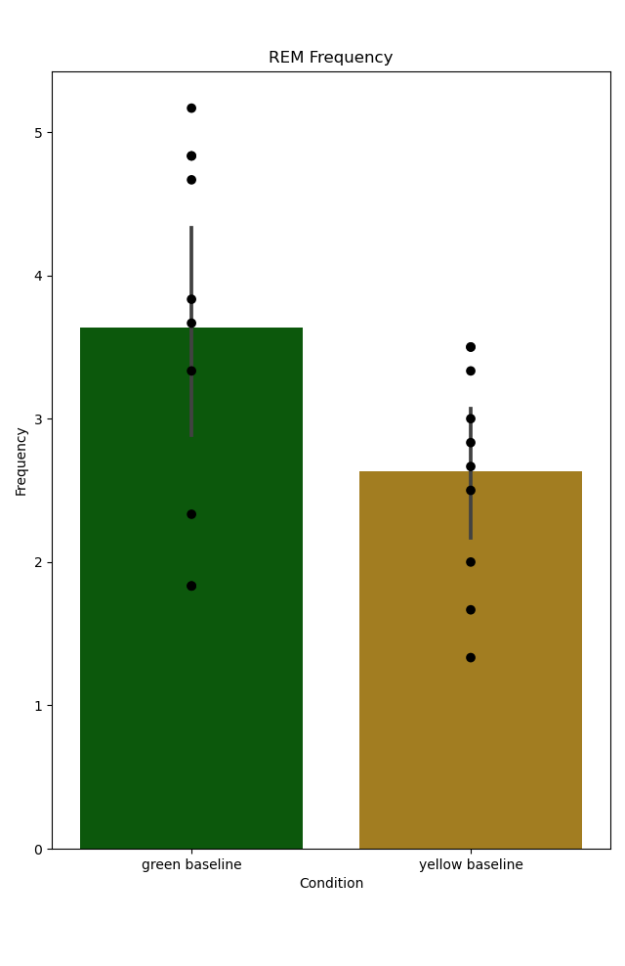
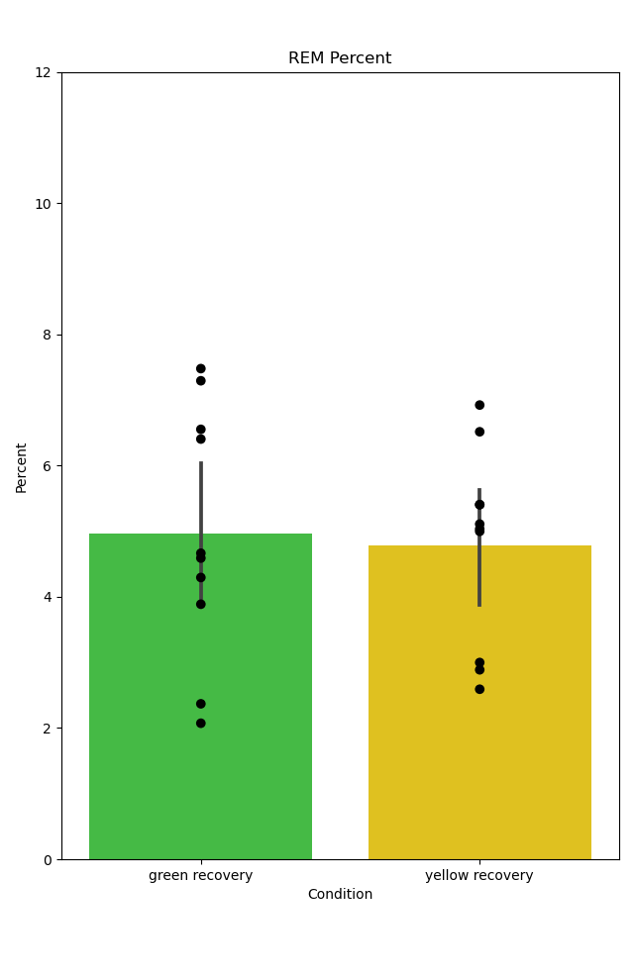
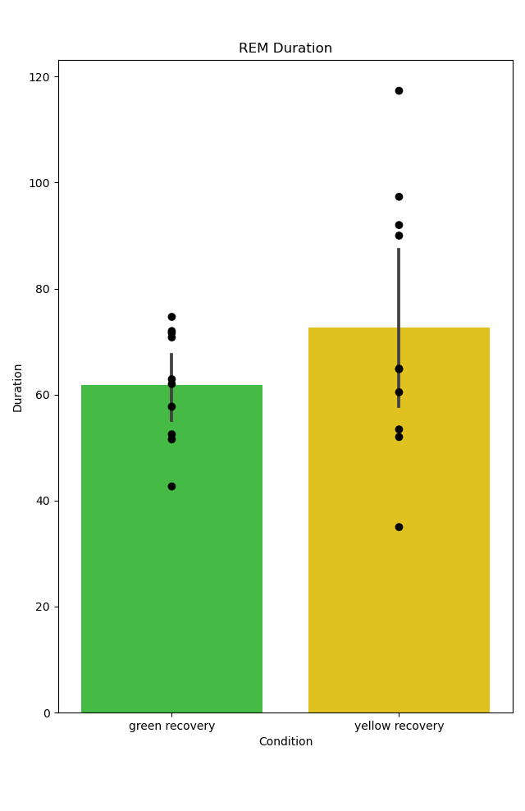
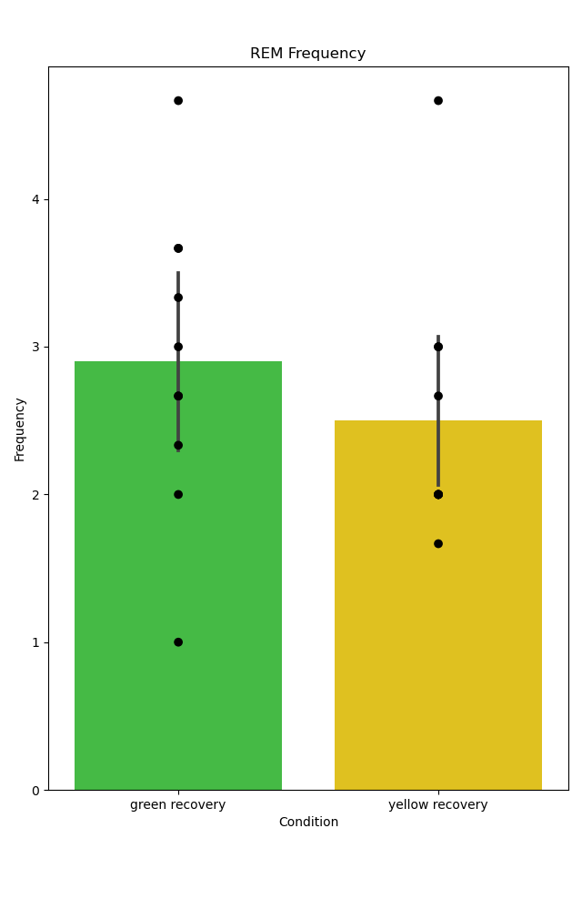
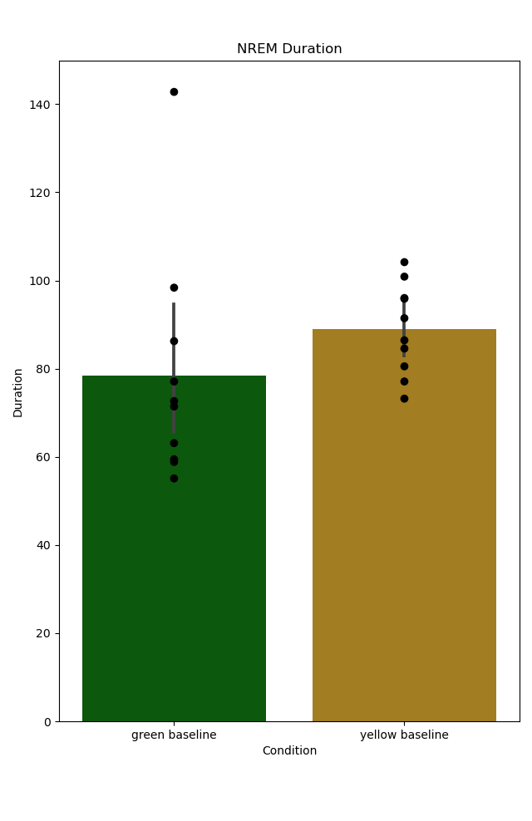
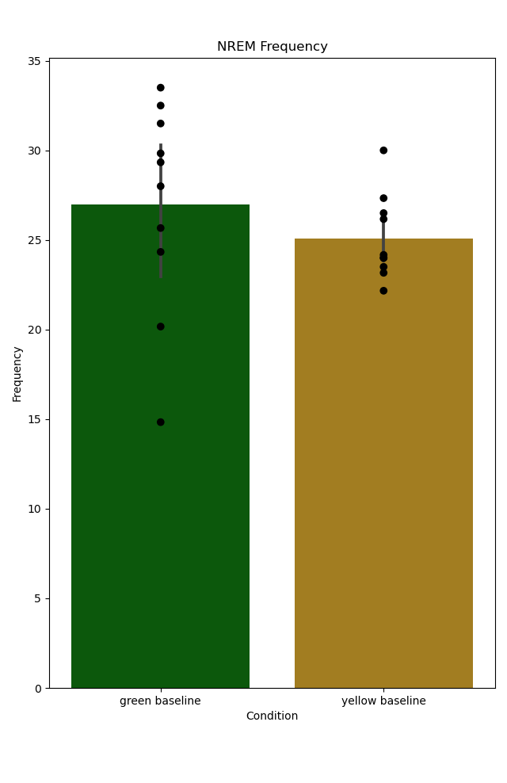
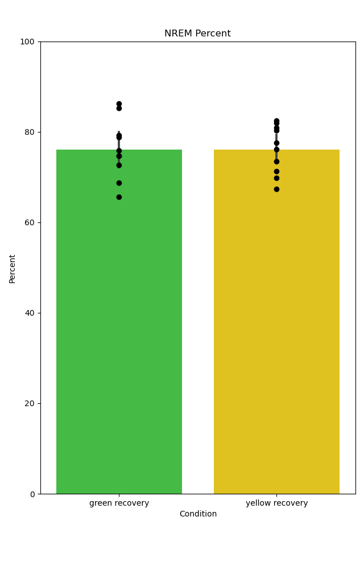
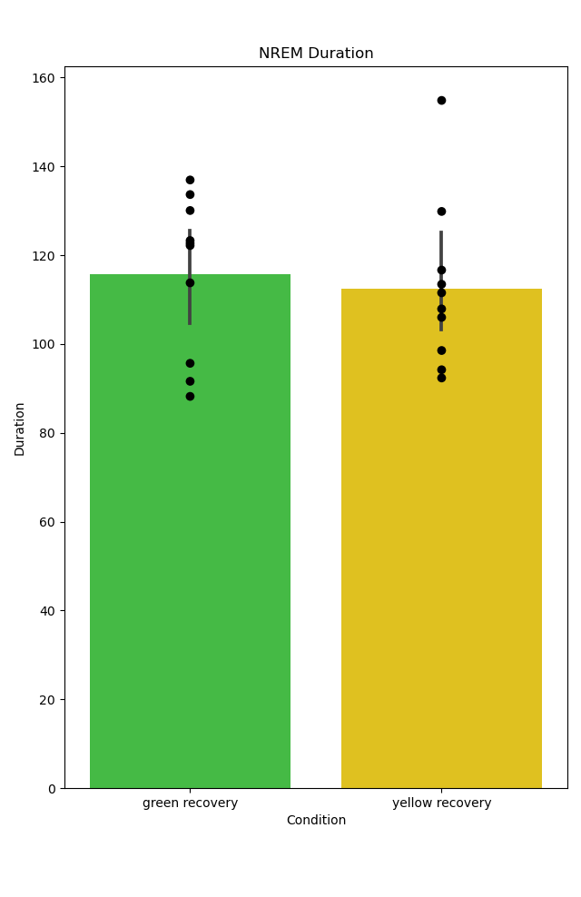
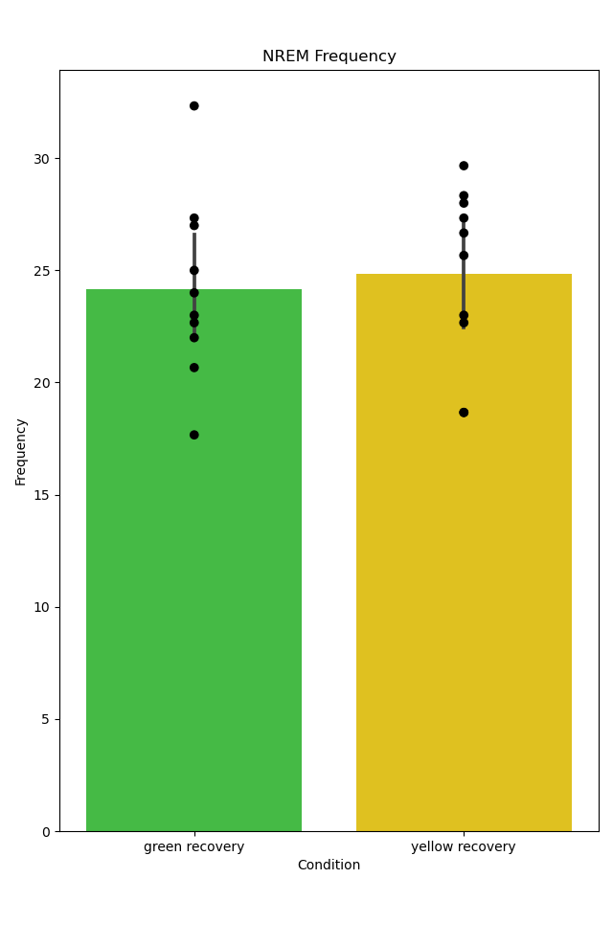
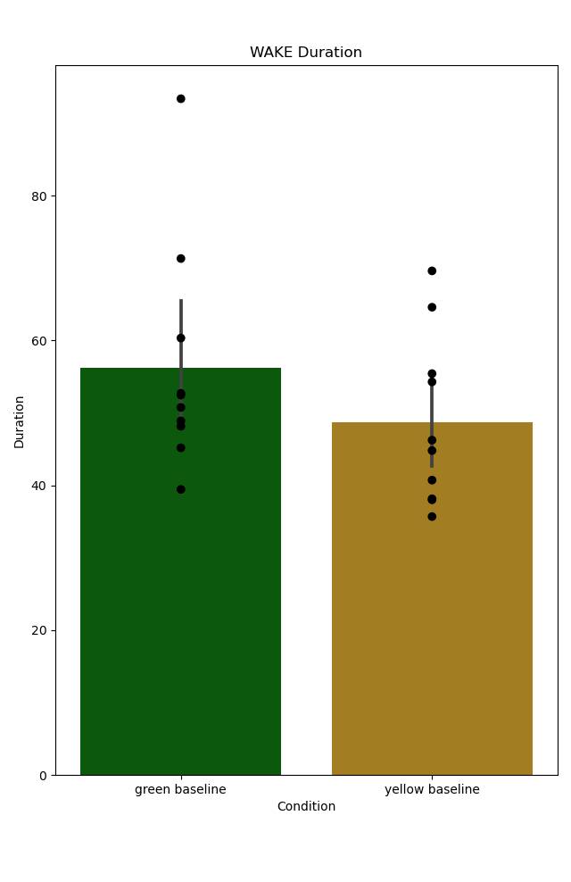

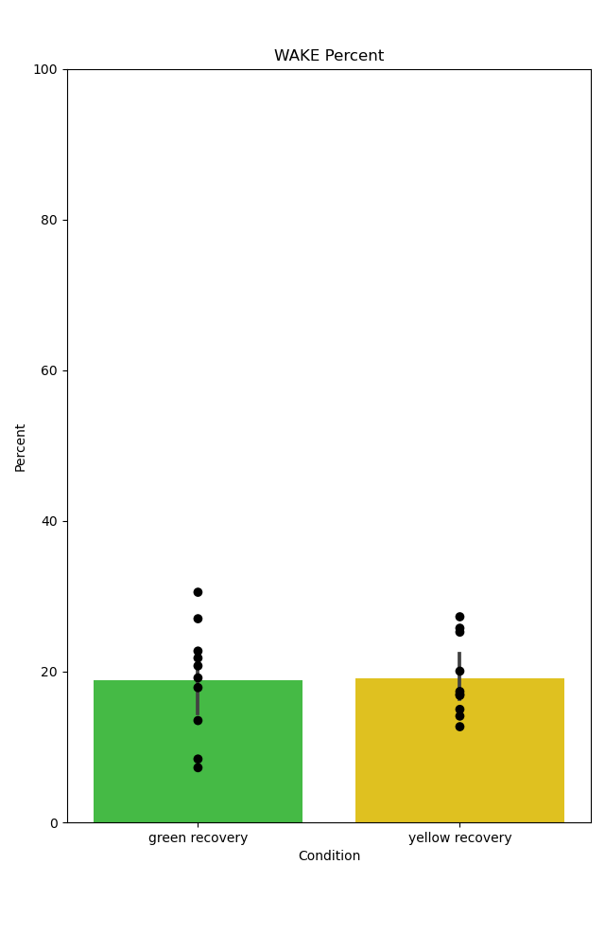
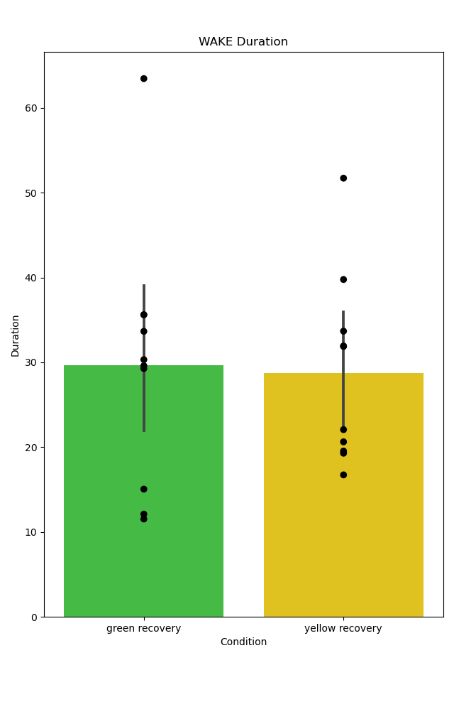
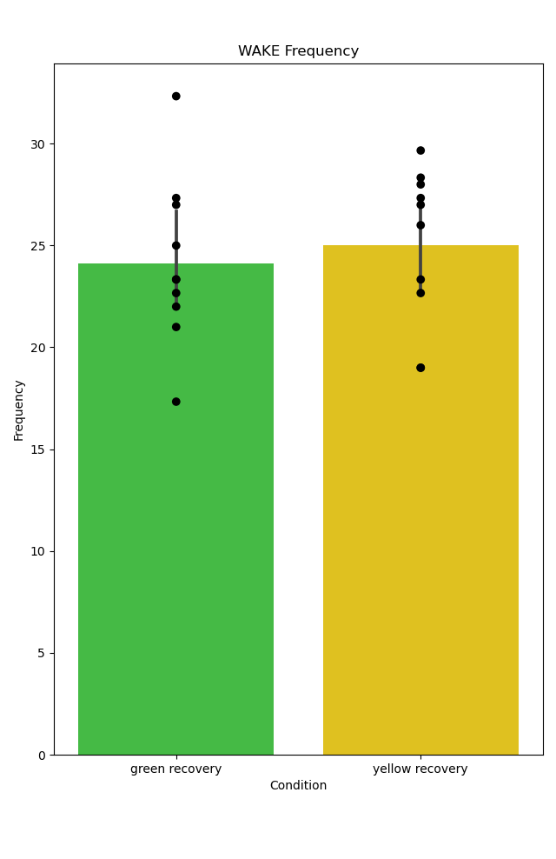
Percent
Duration
Frequency
Percent
Duration
Frequency
P=.385
P=.014
P=.047
P=.824
P=.226
MWU
P=.204
REM
REM
P=.018
MWU
P=.045
P=.364
P=.985
P=.693
P=.7
NREM
NREM
P=.023
MWU
P=.241
P=.442
P=.938
P=.882
P=.618
WAKE
WAKE
6 hour Baseline Comparison
1st 3 hours of Recovery Sleep

Slide 21


















Percent
Duration
Frequency
Percent
Duration
Frequency
P=.283
P=.049
P=.009
WilcoxonP=.483
WilcoxonP=.483
P=.375
REM
REM
P<.001
P=.006
P=.07
P=.001
P=.002
P=.151
NREM
NREM
P<.001
P=.02
P=.104
P=.002
P=.082
P=.164
WAKE
WAKE
3 hours

Slide 22


NREM Percents Mixed ANOVA and Pairwise Comparisons
Mixed ANOVA
Baseline NREM %
P=.018
Significant main effect of sleep condition, no interaction effect
Pairwise Comparisons
Baseline
Recovery
Baseline
Recovery

Slide 23
NREM Percents Mixed ANOVA and Pairwise Comparisons
Mixed ANOVA
Baseline NREM %
P=.018
Significant main effect of sleep condition, no interaction effect
Looking like most relevant metrics of sleep homeostasis in the immediate 6 hours post sleep deprivation are not different. Hypothesis that microglia depletion
affects sleep homeostasis is unsupported / cannot reject Null Hypothesis.
Pairwise Comparisons
Baseline
Recovery
Baseline
Recovery

Slide 24

Future Directions: 18 hour recordings and comparison of sleep metrics during Dark Phase
3 mice per condition (12 18 hour recordings)

Slide 25

First 6 hours of Dark Period
Percent
REM
NREM
Wake
Baseline
Recovery
Baseline
Recovery

Slide 26

Last 6 hours of Dark Period
Percent
REM
NREM
Wake
Baseline
Recovery
Baseline
Recovery

